Slide 1

Speed Dating
Analysis and Matching Recommendation System
Group 2
Brian Christopher Fajardo
Rieko Kadoya
Krist Kikina
Devis Meka
James Paguay
Ching Ju Su
CIS9650
Fall 2020

Slide 2

01
Data Set
02
Descriptive Analysis & Machine Learning
03
Recommendation System
Group Objectives
We will utilize and apply concepts learned in class as well as some machine learning techniques to provide a descriptive analysis and visualizations that demonstrate certain patterns or trends. We will then incorporate those insights to come up with a recommendation system in which the user will find his/her perfect date.
Table of Contents

Slide 3

DATA SET
Source
Dimensions
Matches found
Attributes and Interests
https://www.kaggle.com/somesh24/speeddating
[8378 rows]
x
[121 columns]
Attractiveness
Sincerity
Intelligence
Fun
Ambition
Shared Interests
1380 / 8378

Slide 4
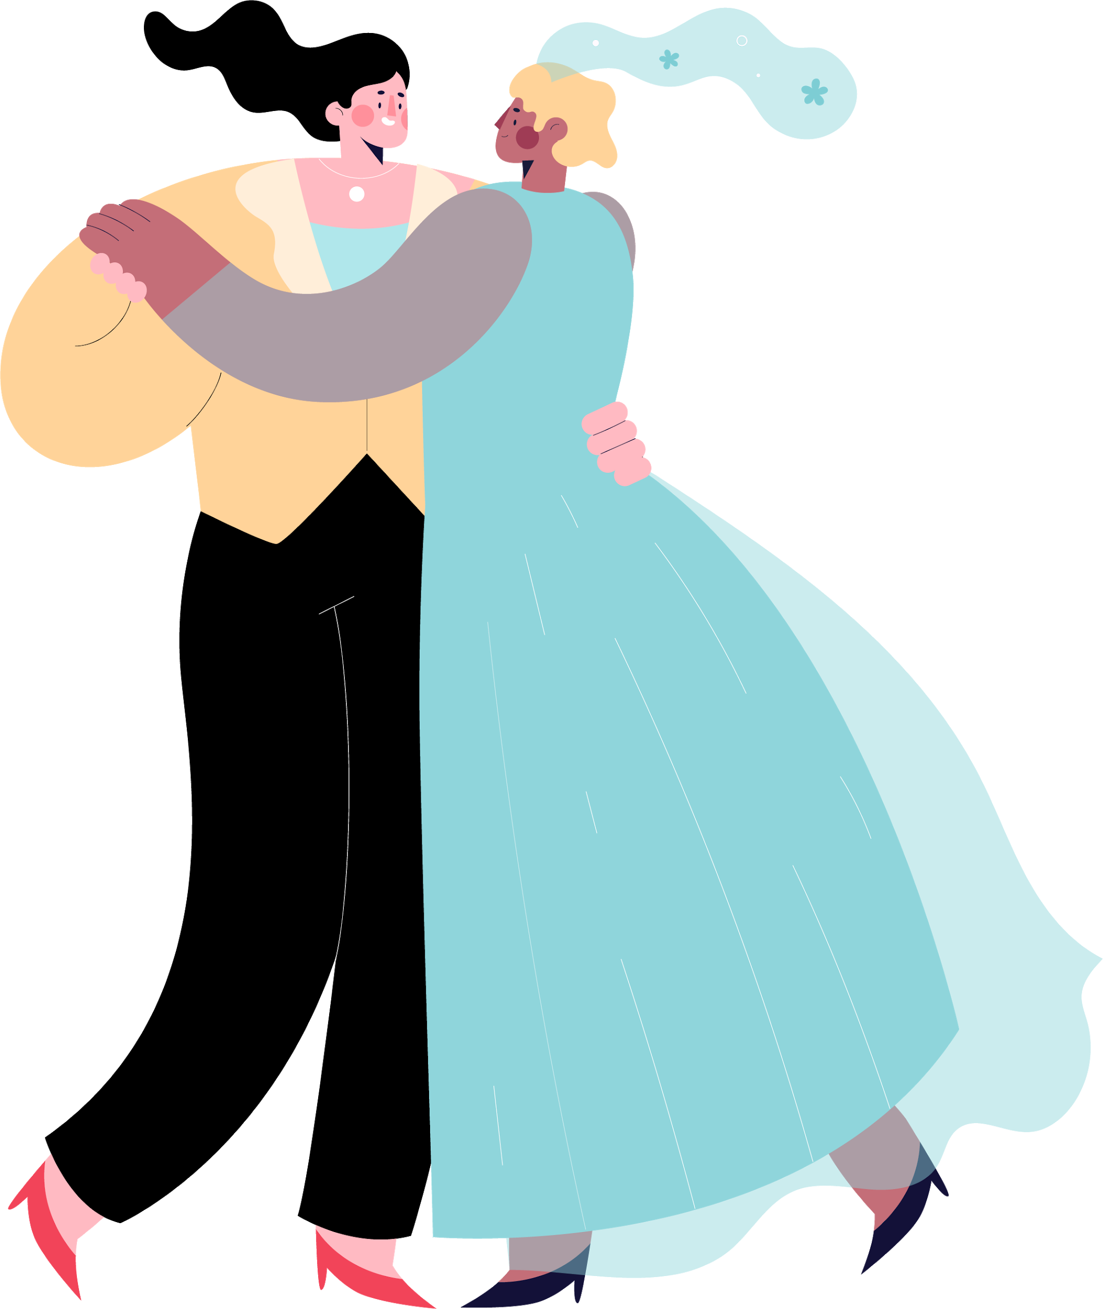
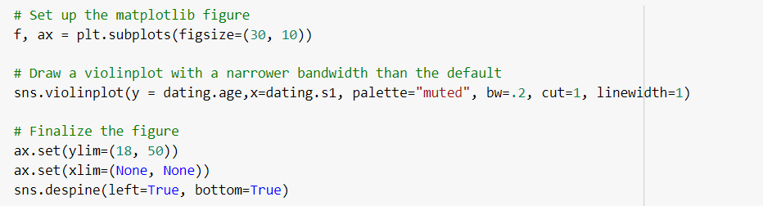
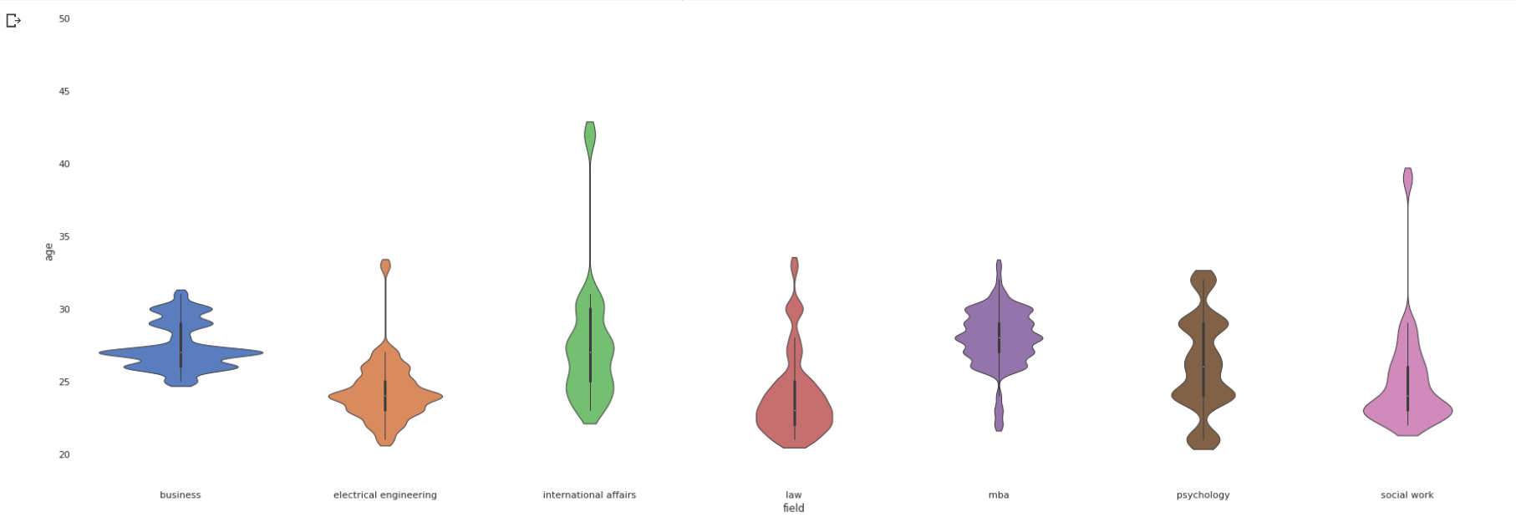
Descriptive Analysis
Violinplot
Distribution of age based on the profession

Slide 5
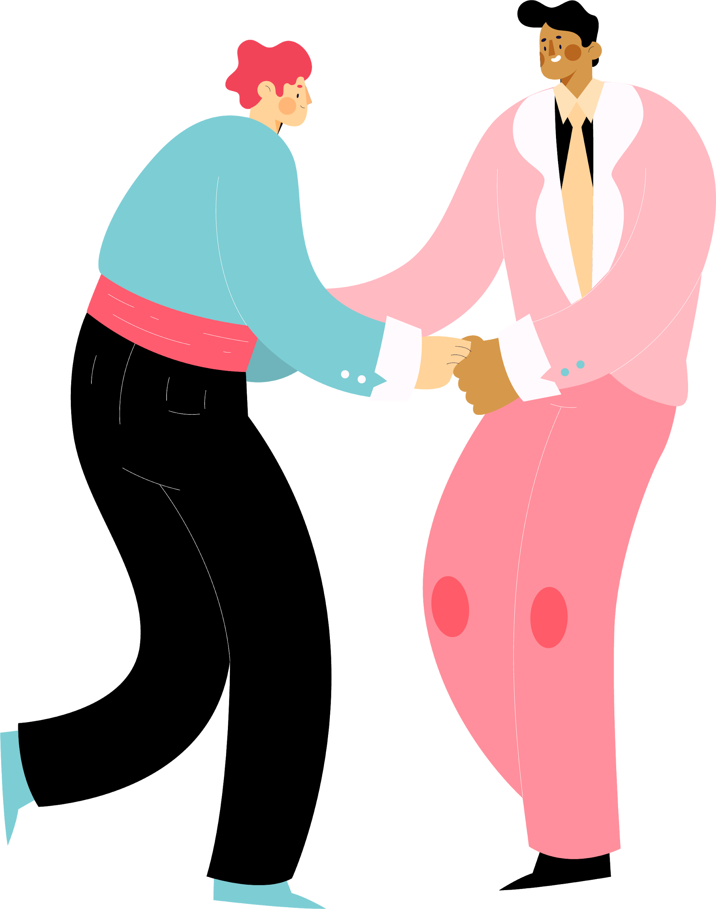
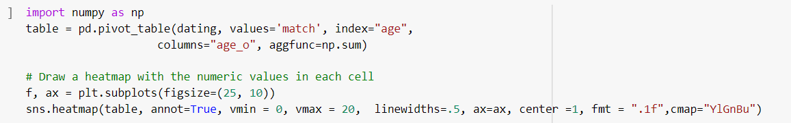
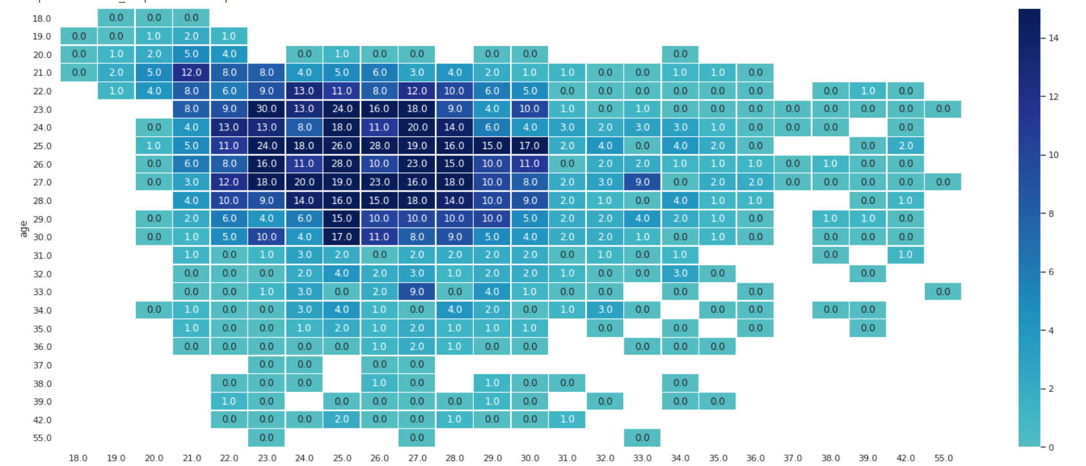
Descriptive Analysis
Heatmap
Heatmap of participants’ ages

Slide 6
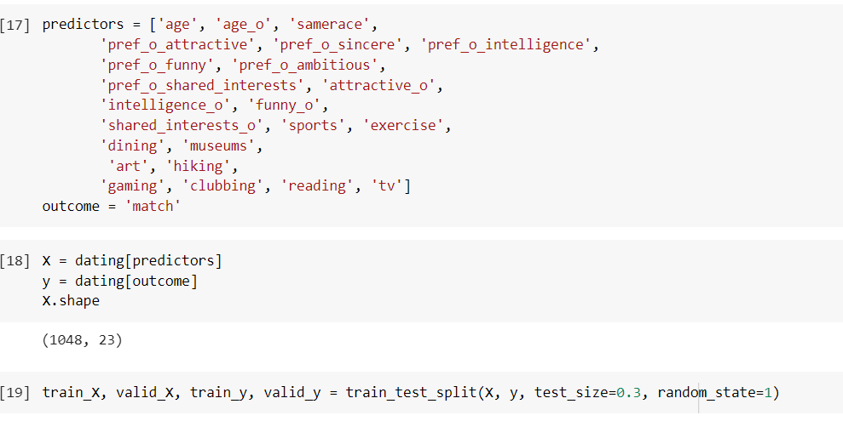
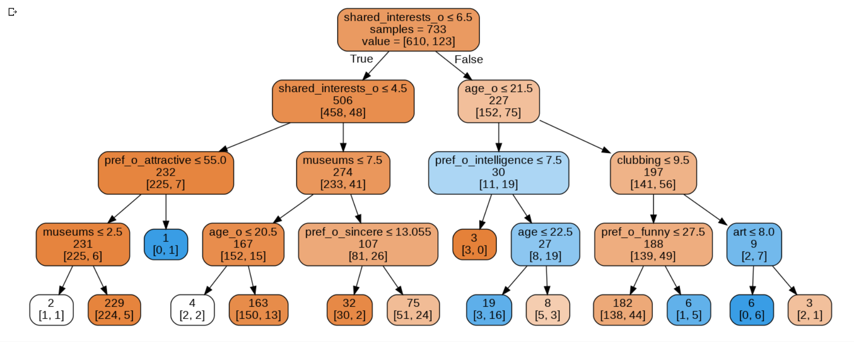
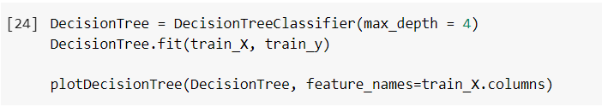
Machine Learning - Decision Tree
xxx
xxxx

Slide 7
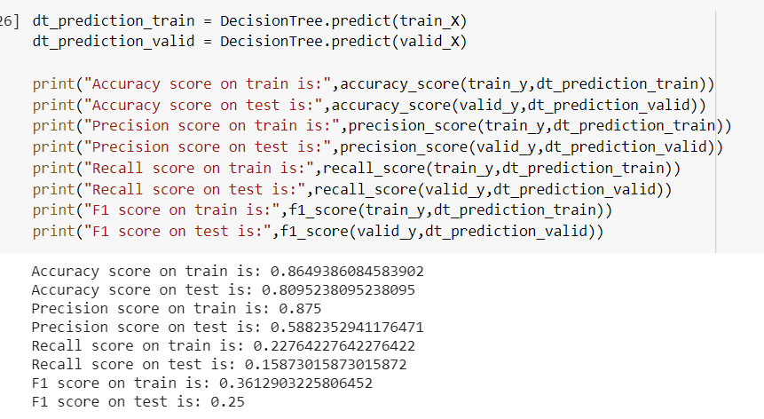
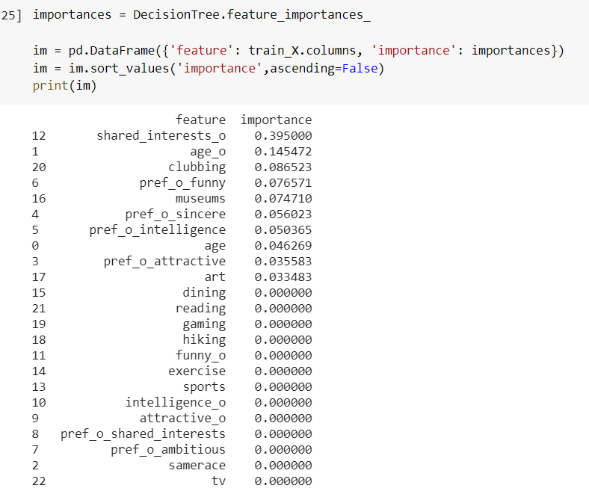
Machine Learning - Decision Tree
xxx
xxxx

Slide 8

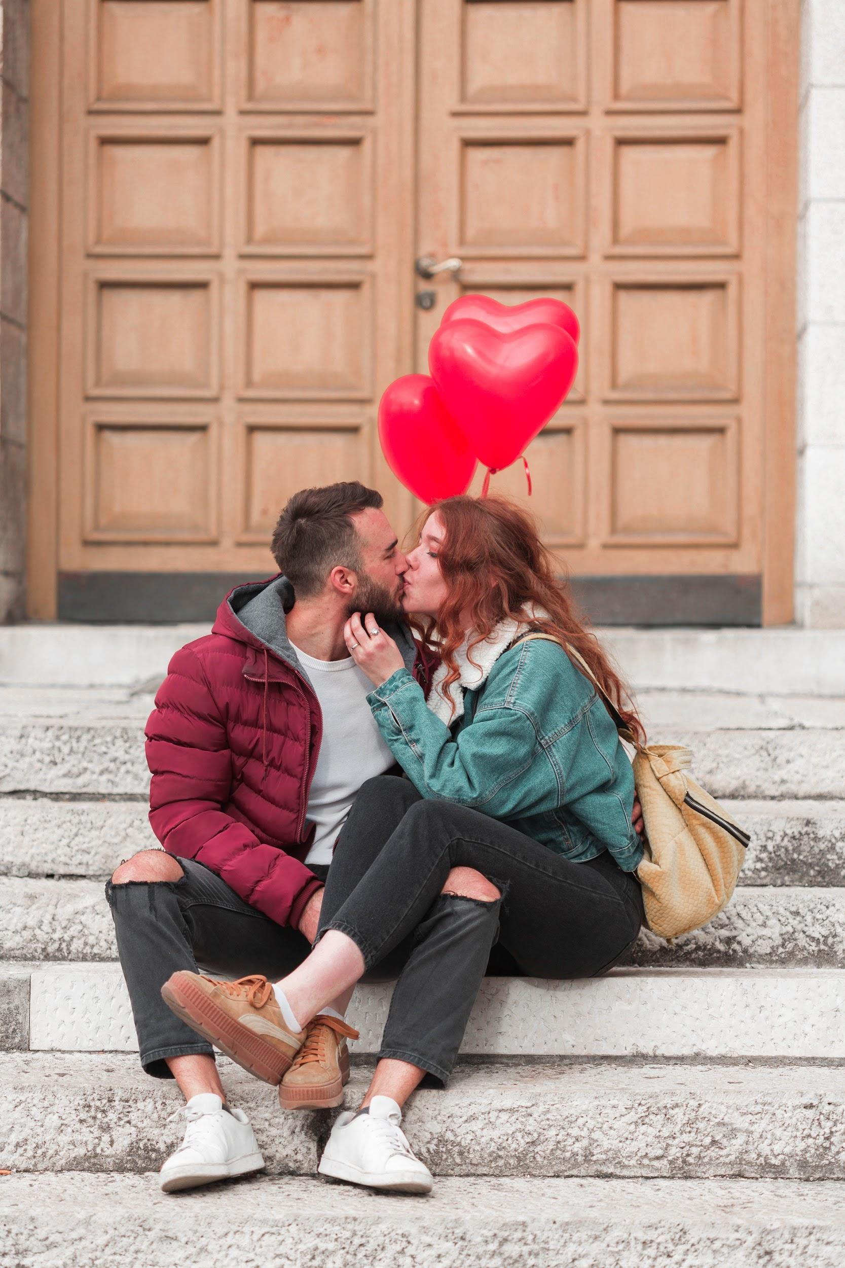

Looking for dates?
Our recommendation system helps you to find good dating partners.
Take a look at our demo!

Slide 9

Thank You!

